Slide 1

From User to Quality Advocate: Becoming a WordPress QA Engineer
Patrick Lumumba
#WCMasaka

Slide 2

Patrick Lumumba
QA Engineer at WPMU DEV
WordPress Contributor
WordPress Developer
Blogger
@lumiblog on X and LinkedIn

Slide 3
Introduction
In this talk, we’ll explore the path to becoming a QA Engineer in the WordPress ecosystem. Whether you’re a developer, content creator, or just passionate about WordPress, QA offers a meaningful way to contribute and build a career.
#WCMasaka

Slide 4
What is QA in WordPress?
QA = Quality Assurance
Ensures WordPress features, plugins, and themes work correctly
Covers manual testing, automated testing, user experience feedback
#WCMasaka

Slide 5
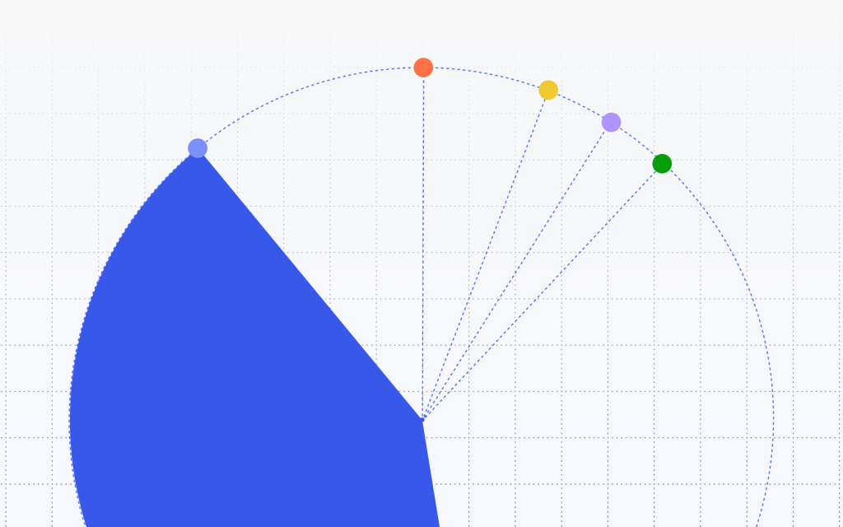
Why QA Matters
Over 40% of the web relies on WordPress
Broken features affect millions of users
QA ensures reliability, usability, and accessibility
#WCMasaka

Slide 6

Who Can Be a QA Engineer?
You don’t need to be a developer
Attention to detail and curiosity are key
Beginners, testers, support agents – all welcome
#WCMasaka

Slide 7
Skills You Need…
Basic WordPress usage
Understanding bug reporting
Familiarity with tools like Trac, GitHub, Test Reports
Basic HTML, CSS, and browser dev tools
#WCMasaka

Slide 8

My Journey
2012: Started as a WordPress user
#WCMasaka

Slide 9
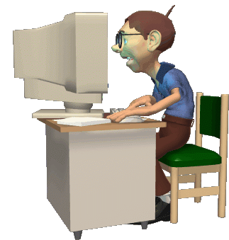
My Journey
2017: Got into WordPress Development
#WCMasaka

Slide 10
My Journey
2021: Contributed to the Test Team
#WCMasaka

Slide 11
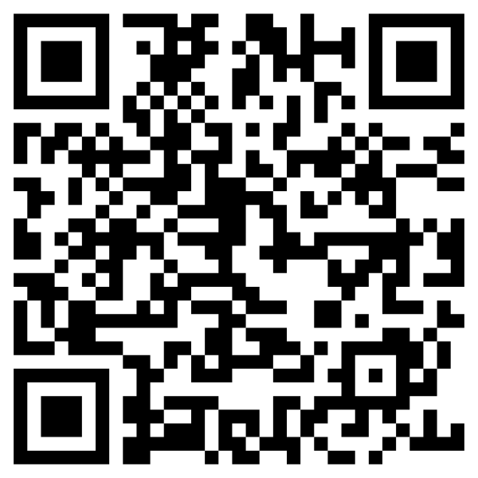
My Journey
2024: Test Co-Lead, WordPress 6.5
#WCMasaka

Slide 12

My Journey
Now: QA Engineer at WPMU DEV
#WCMasaka

Slide 13
Ways to Contribute
Join the Make/Test Team on make.wordpress.org
Test core features and plugins
Report bugs with clear steps to reproduce
Attend test scrub meetings and release parties
#WCMasaka

Slide 14
Common Tools in QA
LocalWP / WP Sandbox
Browser developer tools
Your curiosity and attention to detail
GitHub and Trac
#WCMasaka

Slide 15

Q&A Time!
Let’s take a moment for your questions
before we wrap up.
#WCMasaka

Slide 16
How to Get Started
Join the Test Team: make.wordpress.org/test
Grow your skills in HTML, CSS, JavaScript and PHP
Take some QA courses
Learn how to use QA automation tools like Cypress, Playwright
Practice, practice, practice.
#WCMasaka

Slide 17
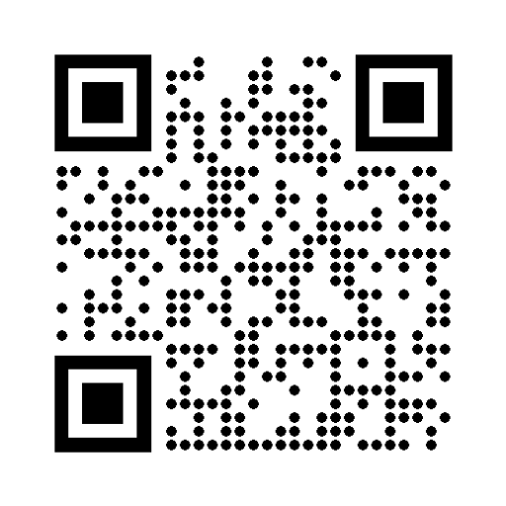
Let’s connect…
@lumiblog on X and LinkedIn

Slide 18
Thank you!
#WCMasaka

